Slide 1


A hitchhiker’s guide to confronting multispecies size spectrum models with data (10 Tips)
Associate Professor Julia Blanchard
julia.blanchard@utas.edu.au

Slide 2
Tip # 1
Join: https://groups.google.com/forum/#!forum/size-spectrum-models
Notes:
Mizer group
Githib – follow
Emails, phone, home address

Slide 3
Tip # 2 Draw the model and the components
What are the questions and goals of the model
Why is this modelling approach appropriate?
Are particular species needed or full ecosystem?
Decide on spatial scale and units
Woodworth-Jefcoats, Blanchard & Drazen. 2019 Frontiers in Marine Science
Reum et al 2019 Oikos

Slide 4
Tip # 3 Define your expectations and criteria for what a ‘good’ model is?
What would you like the to successfully predict?
How will you measure if the model is good enough?
Are there some criteria you have in mind?

Slide 5
Assessing when your model is good enough depends on your expectations
Time-averaged states?
Trends?
Regime shifts?
Analysis of steady state
Analytical
Simulation-based
Pattern oriented or optimisation
Fixed inputs
Time averaged data
e.g.
Biomass
Species size spectra
Growth rates
Catches
Time series forcing (or fitting)
Simulation-based examining departures from steady state
+ Time varying input parameters
+ Time varying observations
e.g.
Species size spectra
Biomass
Growth rates
Catches
Time series forcing (or fitting)
Stability analyses
Simulation-based
Multiple drivers
+ Alternative conditions inputs and outputs (time/space)
+ Time/space/state varying observations
e.g.
Species size spectra
Biomass
Growth rates
Catches

Slide 6
Tip #4 Match model parameters and outputs to potential data
Literature and/or datasets
Range of parameter values
Independence of data for: parameterisation, calibration and evaluation

Slide 7
Tip # 5 Scrutinise assumptions for your application

Slide 8
Tip # 6 Calibration: start simple
Identify which parameters to estimate (not all at once)
I usually try identify the uncertain parameters but also they need to be linked to model goal.
‘Tuning’ may be enough (Gustav’s example)
Parameter estimation

Slide 9
Toy Example #1 Simple parameter estimation
Aims:
Explore fitting a community size spectrum model to observed size spectrum
Two parameters to vary: fishing mortality rate and background carrying capacity kappa)
Open “toyexample1.Rmd”

Slide 10
With parameter estimation we’ve talked about Hand tune Simple grid search Optimisation

Slide 11
Tip # 7 Reduce the parameter space with ecological criteria
Examples:
Predictions need to be within specific range of biomass values (e.g. 20%)
No declines/extinctions in biomass without fishing
Negative size spectrum slope
Growth rates within specified range
REJECT parameter estimates if criteria not fulfilled
Find best estimates and rerun optimisation

Slide 12
Tip # 8 – Consider uncertainty
Different types of uncertainty
Process uncertainty (e.g. recruitment variability, natural mortality variability, birth-death processes).
Observation uncertainty (e.g. CVs for abundance estimates).
Model uncertainty (is the model we chose correct; how many alternative models fit the data adequately?)
Estimation uncertainty – given a model and some data, how well do the data determine the parameters (and predictions) of the model.
Implementation uncertainty – given a management decision, can it be enforced?

Slide 13
Model uncertainty
Multispecies Size Spectrum
3 sub-models calibrated
to time-averaged data
and cross validated
1. Full feedback
2. Fixed growth
3. Single species
Context: exploring Marine Strategy Framework Directive indicators & targets
Notes:
Here 3 different assumptions varied:
Dynamcial growth & predation mortalty ( full feedback)
Fixed empricial ( von Bertalanffy growth) ( fixed growth, but dynamic predation mortality)
3. Fixed growth and predataion mortality
All models fit on time-averaged Biomass and Landings form stock assessments ( input : Fishing mortalty rates
Cross-validated independently against survey size distributions ( shown )

Slide 14
Greater differences revealed under future scenarios
1. Full feedback
2. Fixed growth
3. Single-species
Notes:
Evaluate risk
Probability of reachings targets that are closer to unexploited baselines under 2 scenarios
Status quo
If single species Fmsy are simulataneously achieved
Probabilties are for specific targets being achieved for “no stocks collapsed” (top left), “large fish indicator” at or above proposed target
And bottom is relative yield
The reason why the single-species model variant (red) fails top two is associated with high unexploited baselines for the size spectrum – it is not constrained by prediation mortality – and is actually unrealsitic
Dynamic predation and growth constrain the structure of the community

Slide 15
Tip # 9 – Walk before running with dynamics
Care in thinking about your original questions and expectations
Numerical errors
Recruitment ?
Feedbacks
Phase space
Consider multiple models/parameterisations, comparisons and tests
Time series fitting?
Skill evaluation with time series (predictive skill, forecasting)

Slide 16
Toy Example # 2 Exploring changes through time
Aims:
1) Main steps involved in forcing a size spectrum model
2) Visually compare some of the model predictions with time-series data
3) Explore how post-hoc parameter changes can affect apparent model skill through time

Slide 17
Tip # 10 Don’t be afraid to change things
Model doesn’t capture your assumptions/data?
– change the model!
Iterative approach
Be creative in asking questions
Consider limitations
Compare with other modelling frameworks
observation models

Slide 18
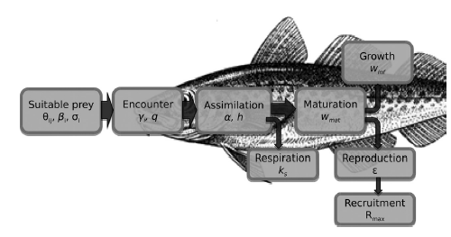
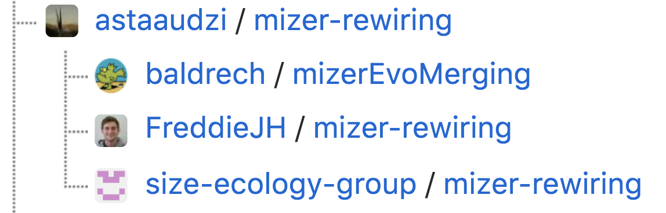
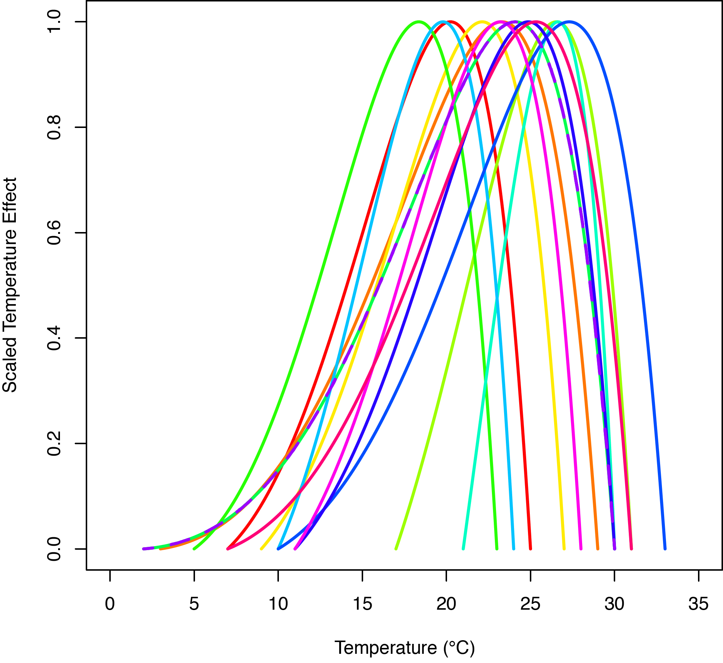
How to implement other time-varying inputs
Extensions include climate change applications:
Temperature effects
Plankton and resource dynamics
Benthic and detrital dynamics
Fleet dynamics
Temperature
Individual-level
VS

Slide 19
Questions and discussion

